Slide 1
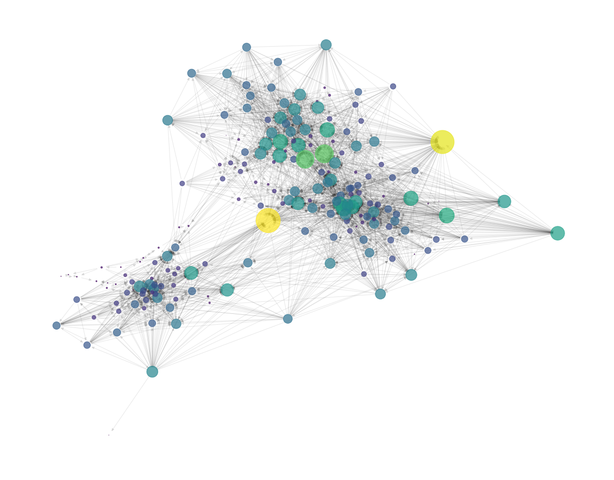
Jazz musician network

Slide 2
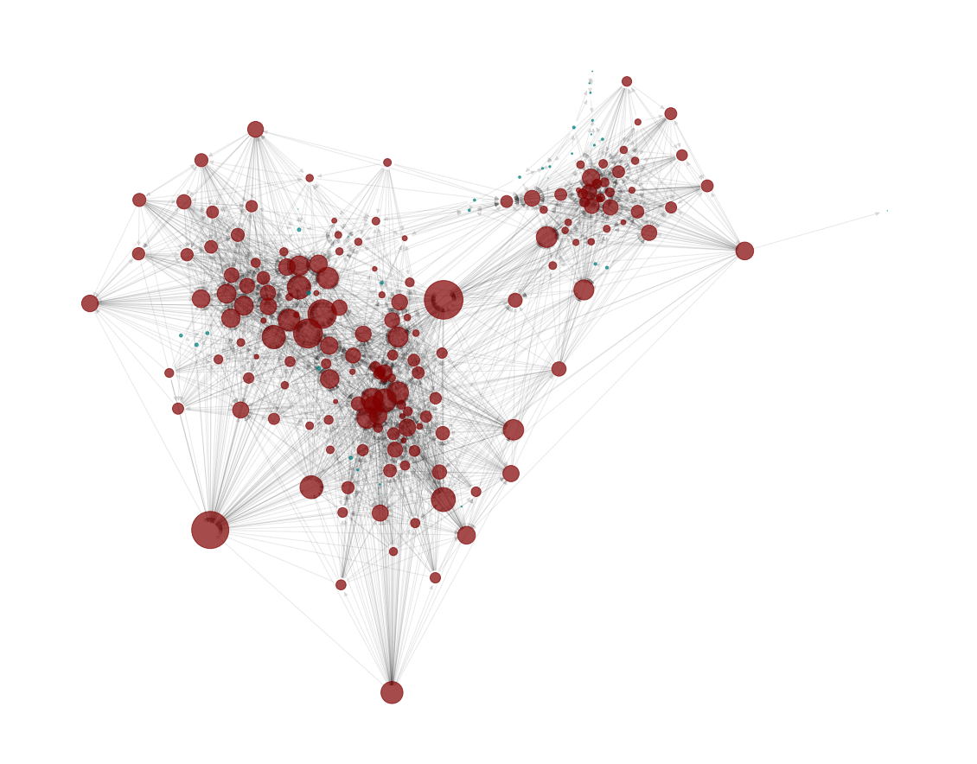
number of nodes: 198
number of edges: 2742
average degree: 27.69

Slide 3
Community
> girvan newman
> greedy modularity
> cliques
> Fluid Communities

Slide 4
girvan newman algorithm
The Girvan-Newman algorithm for the detection and analysis of community structure relies on the iterative elimination of edges that have the highest number of shortest paths between nodes passing through them. By removing edges from the graph one-by-one, the network breaks down into smaller pieces, so-called communities. The algorithm was introduced by Michelle Girvan and Mark Newman

Slide 5
The idea was to find which edges in a network occur most frequently between other pairs of nodes by finding edges betweenness centrality.
The Girvan-Newman algorithm can be divided into four main steps:
- For every edge in a graph, calculate the edge betweenness centrality.
- Remove the edge with the highest betweenness centrality.
- Calculate the betweenness centrality for every remaining edge.
- Repeat steps 2-4 until there are no more edges left.

Slide 6
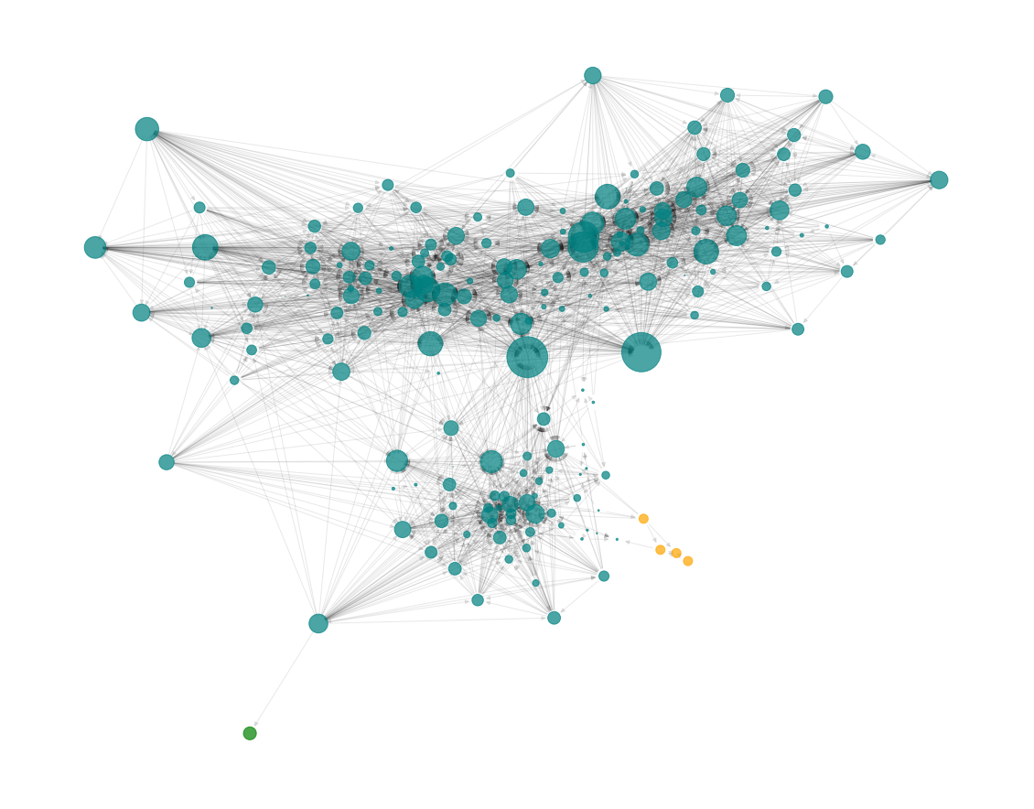
> number of communities: 3
> number of nodes: 198
> number of edges: 2742
> - first community teal nodes: 193
> - second community orange nodes: 4
> - third community green nodes: 1

Slide 7
greedy modularity communities
Find communities in G using greedy modularity maximization.
This function uses Clauset-Newman-Moore greedy modularity maximization to find the community partition with the largest modularity.
Greedy modularity maximization begins with each node in its own community and repeatedly joins the pair of communities that lead to the largest modularity until no further increase in modularity is possible (a maximum).

Slide 8
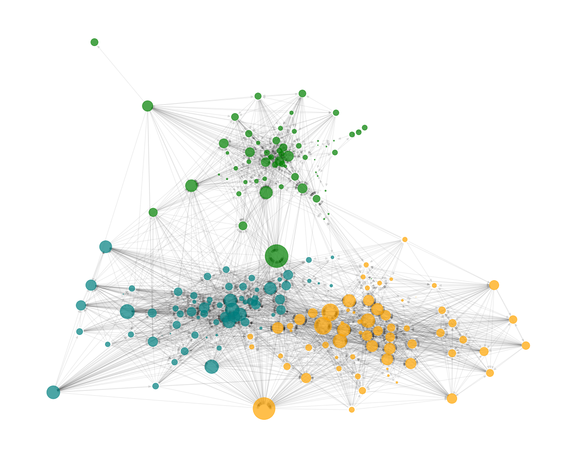
> number of communities: 3
> number of nodes 198
> number of edges 2742
> first community *teal* nodes 69
> second comunity *orange* nodes 66
> third community *green* nodes : 63

Slide 9
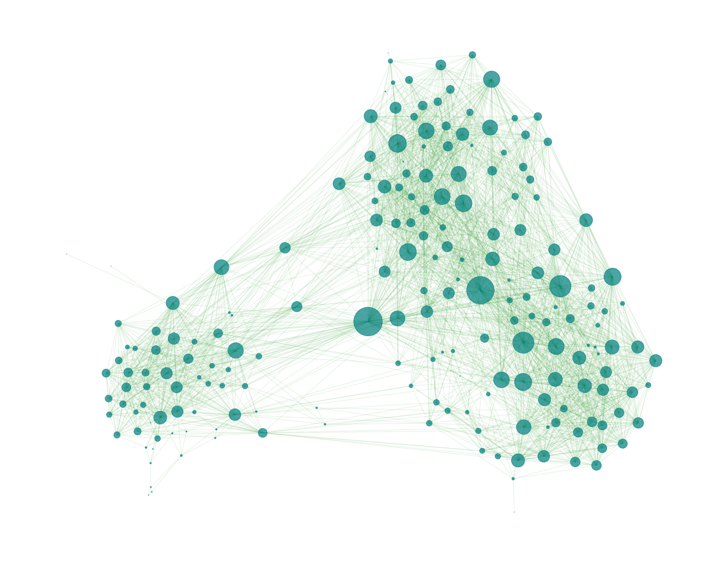
CLIQUES
A clique of a graph G is a set X of vertices of G with the property that every pair of distinct vertices in X are adjacent in G.

Slide 10
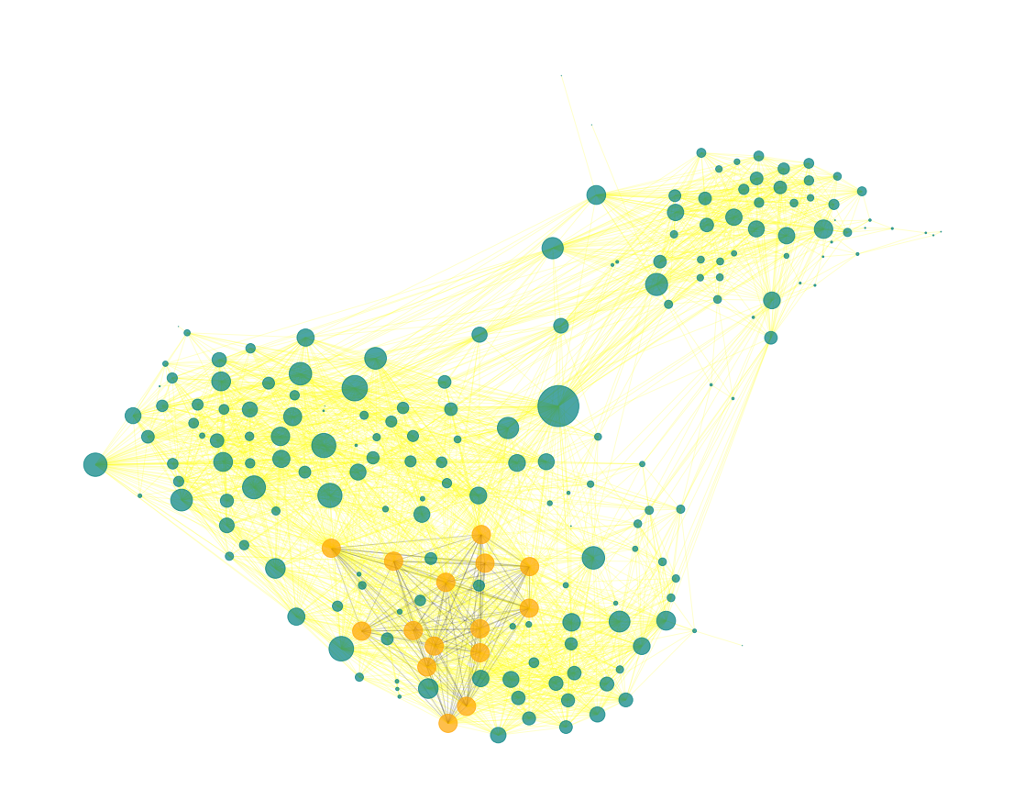
yellow nodes are all nodes which are a clique choosing randomly from set of all cliques
> number of cliques in jazz network: 746

Slide 11
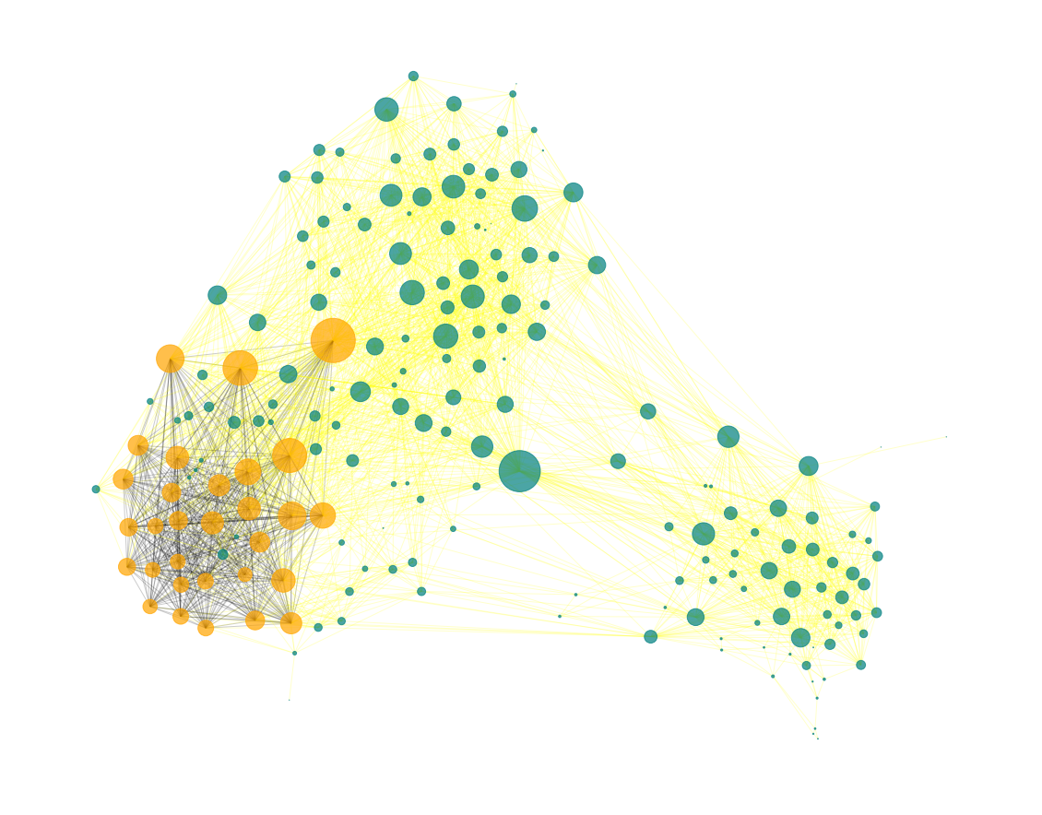
Biggest clique
>> number of nodes: 30

Slide 12
Fluid Communities algorithm
The algorithm is based on the simple idea of fluids interacting in an environment, expanding and pushing each other. Its initialization is random, so found communities may vary on different executions.

Slide 13
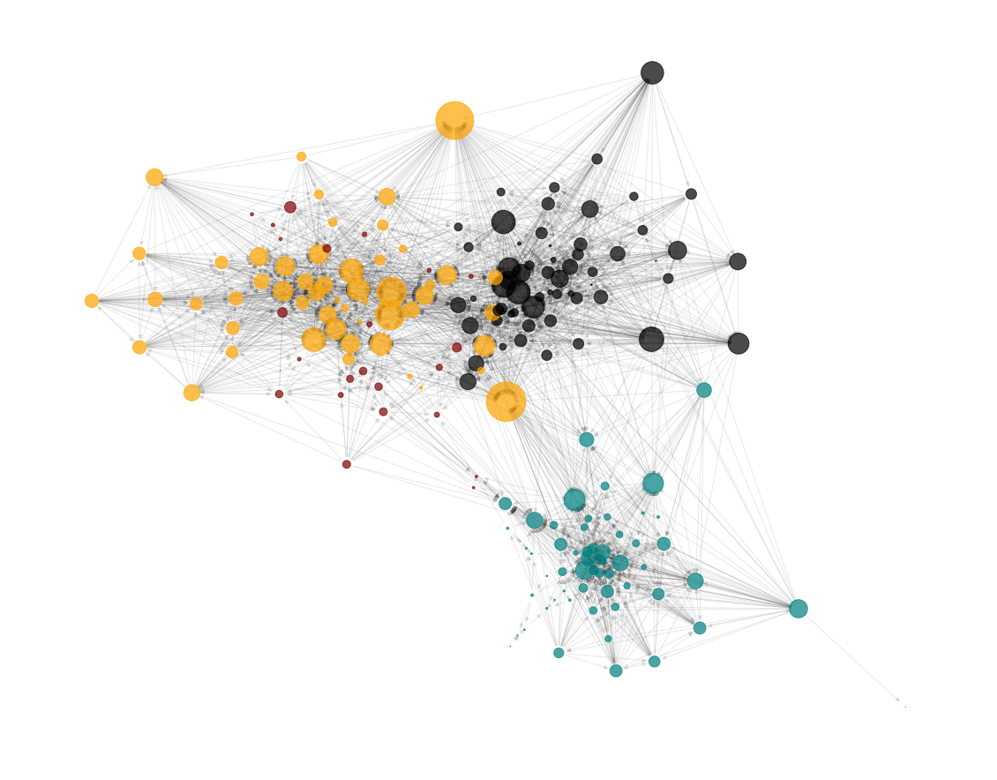
> number of communities: 4
> number of nodes: 198
> number of edges: 2742
> first community maroon nodes: 41
> second community teal nodes: 57
> third community black nodes: 57
> fourth community orange nodes: 22

Slide 14
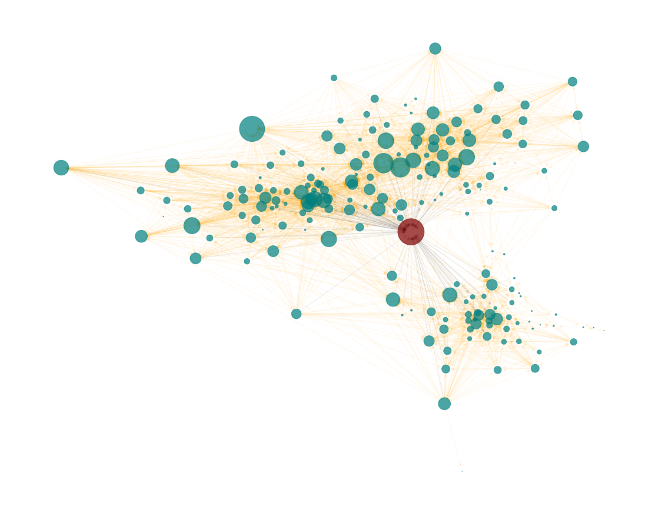
The most important, relevant, influential, or central nodes
> degree of the most connected: 100
>> id of the most node: 136
> average degree:27.696969696969695

Slide 15
brief conclusion
> girvan newman
there are 3 communities, the two smallest did not have any relation with the biggest community
> greedy modularity
there are 3 communities with quite the same number of integrantes, it means 3 big groups of influence each one with his own most popular integrant, but the green community has the most famous musician
> cliques
There are many cliques but the biggest clique is almost 3o integrantes form 198(15%) know each other like a community, maybe all of them go to the the same bar
> Fluid Communities
each community are connected like a fluid, maybe each community can be rename like a name of the city where live the integrants of these groups

